Slide 1

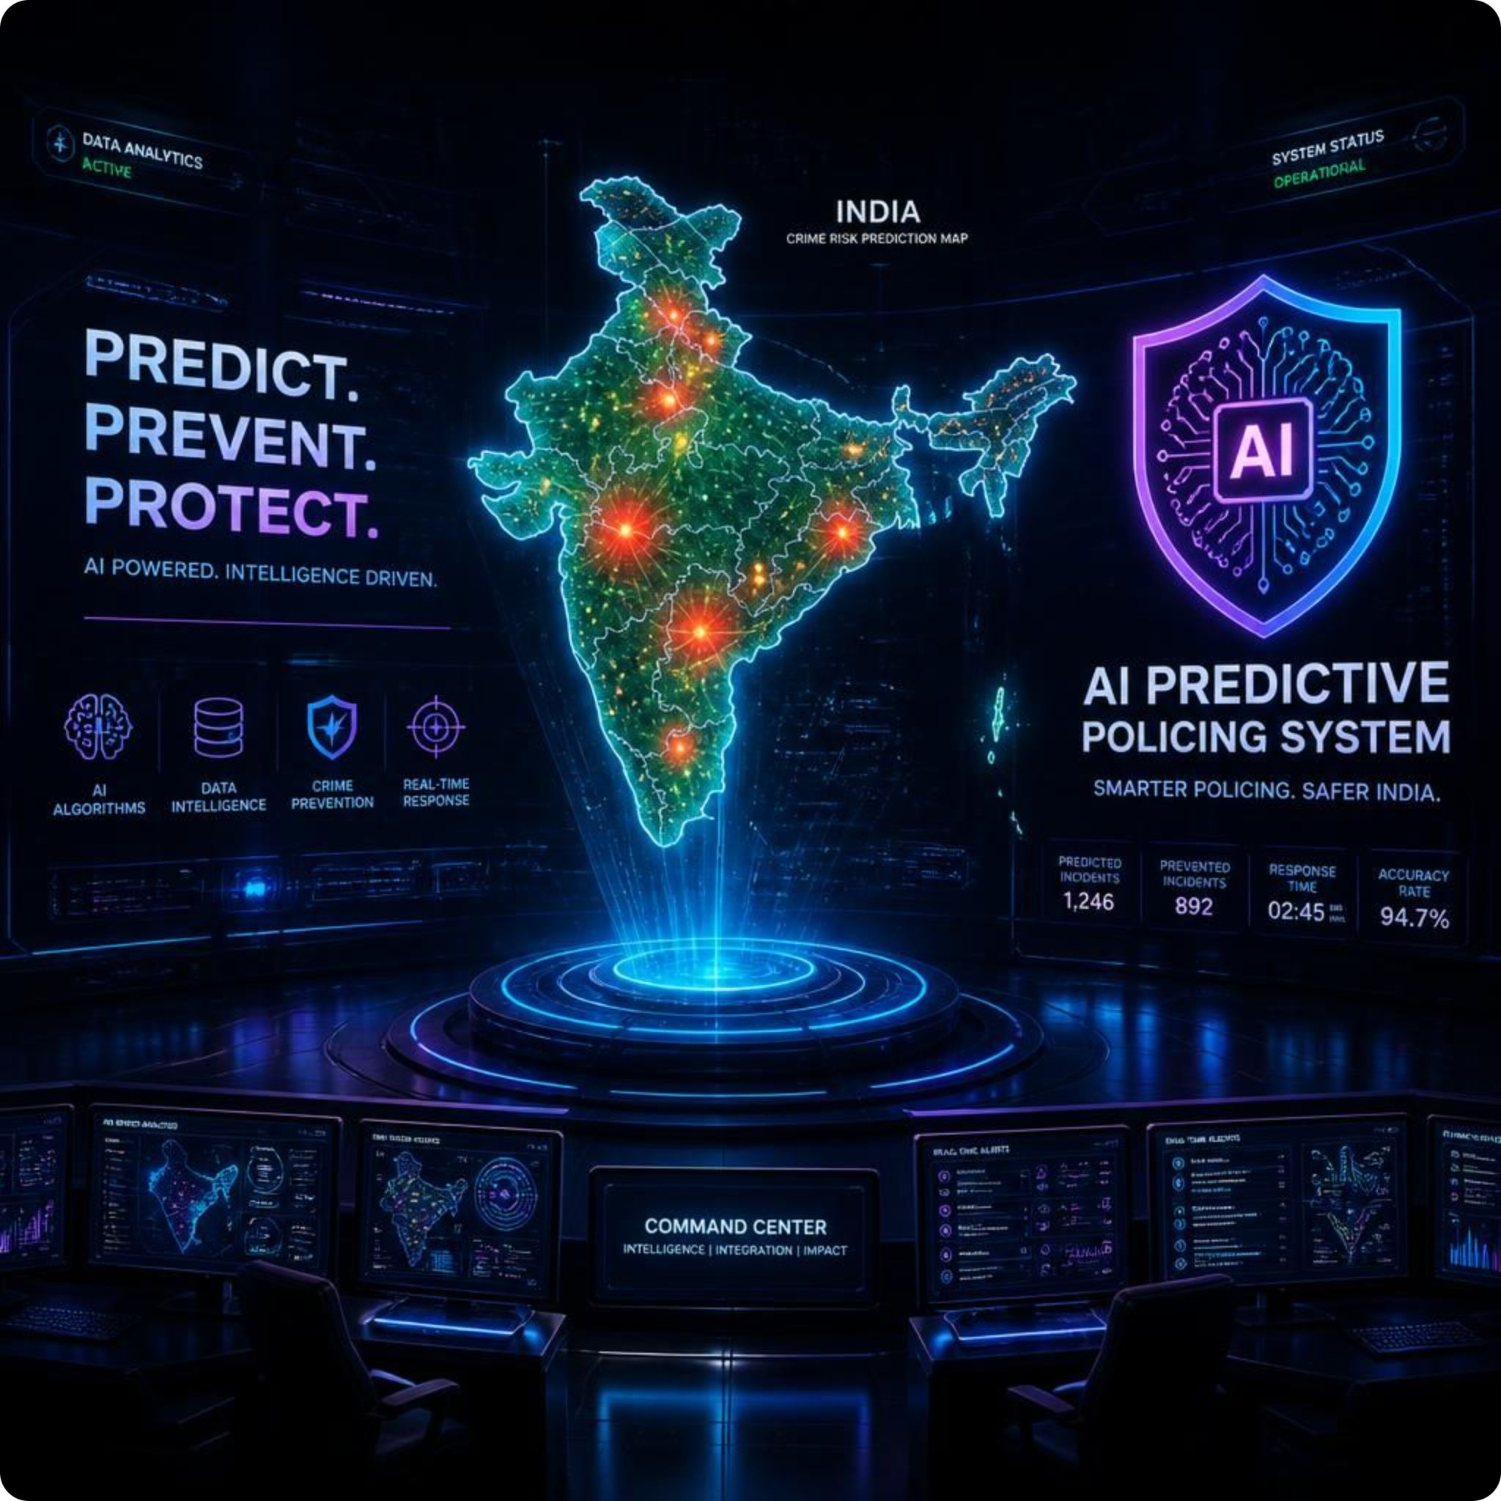
Crime
Vision
An Integrated Machine Learning Based Crime Analysis and Forecasting System with Web Visualization
An End-to-End Predictive Policing & Citizen Safety Framework using Machine Learning, Web Scraping & Geospatial Analytics
Domain: Computer Science & Engineering / Machine Learning & Data Science
Presented By: Pearl Kayastha(2300290100170),Riya Bhardwaj(2300290100211),
Priya Shalini(2300290100189),Nipun Mittal(2300290100165)
Guided By: Dr. Nishu Gupta
Institution: KIET Group Of Institution

Slide 2
OVERVIEW
Introduction & Background
01
02
The Urban Safety Challenge
The Opportunity
Crime prevention is a critical requirement for urban safety and law enforcement planning across India. Millions of crime records are logged annually by the National Crime Records Bureau (NCRB).
Historical crime records contain spatial-temporal patterns that can forecast future crime hotspots — a vast, underutilized intelligence resource.
03
04
Our Core Idea
Problem Statement
Transition from Reactive Policing (responding after a crime occurs) to Predictive Policing (allocating resources before a crime occurs).
Massive NCRB reports sit in static formats. Patrol units are spread uniformly. Citizens lack a single safety portal. Existing models ignore live crime news.
05
06
Project Objectives
Key Deliverable
Build unsupervised hotspot zoning, high-accuracy risk classification, time-series forecasting, live geospatial intelligence, and actionable citizen & police utilities.
An integrated Flask-based web platform serving both law enforcement and the general public with real-time AI-powered crime safety intelligence.

Slide 3




PROBLEM SPACE
Problem Statement & Key Challenges
Current crime analysis systems in India suffer from fundamental limitations that prevent effective proactive law enforcement and citizen safety awareness.
Sub-optimal Resource Allocation
Data Underutilization
Uniform Patrol Distribution
Limited police patrol units are distributed uniformly instead of targeting high-vulnerability corridors identified by data.
Static CSV/PDF Formats
Massive historical NCRB reports remain inaccessible without real-time predictive tools to extract actionable intelligence.
Static Analysis Only
No Citizen-Centric Safety Tools
No Live News Integration
Existing academic models lack live web scraping to factor in ongoing crime news events and real-time intelligence feeds.
No Unified Safety Portal
Travelers and citizens have no single portal to check district safety scores, emergency helplines, or safe travel routes.

Slide 4




COMPARISON
Proposed System vs. Existing Systems
Why Our System Is Fundamentally Different
Traditional crime analysis relies on manual lookups and reactive reporting. CrimeVision introduces AI-driven predictive analytics, live data pipelines, and dual-audience accessibility — a paradigm shift from static bureaucracy to dynamic intelligence.
Feature-by-Feature Comparison
Approach
ML Algorithms
Live News & Mapping
Accessibility
Existing: Manual statistical lookup / Reactive
Ours: AI Predictive Analytics & Hotspot Zoning
Existing: Basic single-variable regression
Ours: K-Means + Random Forest (97.3% Acc) + Exponential Smoothing
Existing: Not integrated / Static 2D plots
Ours: Real-time Selenium Scraper + Interactive Folium Geospatial Heatmap
Existing: Police internal use only
Ours: Dual Public Portal & Restricted Police Dashboard (/police-dash)

Slide 5








ARCHITECTURE
System Architecture & Workflow
End-to-End Pipeline
NCRB Raw Data (data.gov.in) + Live Scraped Crime News
The system ingests government NCRB datasets alongside real-time scraped crime news, applies preprocessing and scaling, then branches into unsupervised clustering and supervised classification before serving outputs through a Flask backend to three key consumer modules.
Data Ingestion & Preprocessing
NCRB + Live News Scraper
Raw data from data.gov.in and Selenium-scraped headlines are cleaned, scaled, and feature-extracted into model-ready vectors
ML Engine
K-Means + Random Forest
K-Means clusters districts into Red / Orange / Green zones; Random Forest forecasts future risk with 97.3% accuracy
Flask Output Modules
Heatmap · PDF Engine · AI Chatbot & SOS
The backend serves an interactive Folium geospatial heatmap, automated PDF report generator, and integrated AI chatbot with SOS panic button

Slide 6

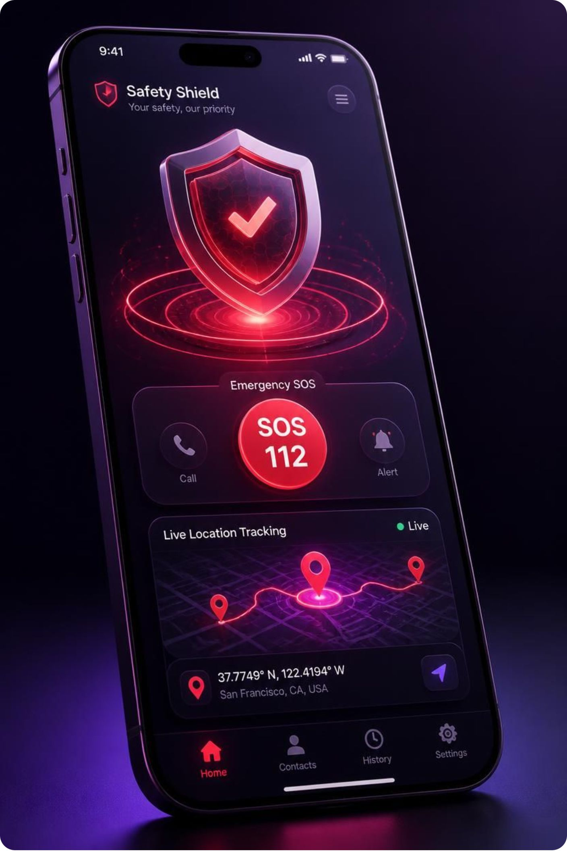
DATA & METHODS
Datasets, Preprocessing & ML Methodology
CrimeVision is powered by three primary data sources processed through a rigorous pipeline and three complementary machine learning algorithms.
01
02
03
Primary
Data Sources
K-Means Clustering
(Unsupervised)
Random Forest
(Supervised)
NCRB · Census · Live News
800+ Indian districts across 36 States/UTs (2001–2021); Census population metrics for per-capita rate calculations; real-time scraped headlines mapped to city coordinates
Silhouette Score: 0.742
Classifies district feature vectors into K=3 clusters — Red (High Risk), Orange (Moderate Risk), Green (Low Risk) — with high cluster segregation quality
97.3% Accuracy
Ensemble of 100 Decision Trees trained on 8 core IPC parameters: Murder, Attempted Murder, Rape, Kidnapping, Dacoity, Robbery, Theft, and Hurt

Slide 7

EXECUTION PLAN
Real-Time Scraping, Forecasting & Key Features
Live News Scraping
Time-Series Forecasting
Geocoding
Folium Heatmap
The live intelligence pipeline combines web scraping, NLP, geocoding, and statistical forecasting to deliver a continuously updated geospatial crime picture for both citizens and law enforcement.
Selenium navigates India Today Crime portal, clicks pagination, and extracts headlines with NLP RegEx city identification.
City entities are resolved to precise Latitude/Longitude coordinates for spatial mapping.
Generates interactive heatmap (final.html) with intensity density gradient overlays for live crime visualization.
Exponential Smoothing (α=0.3) and Geometric Growth Formula project 5-year IPC crime trends and population-adjusted rates.
1
2
3
4
🚨 Emergency & SOS
📄 PDF Report & Risk Score
🤖 AI Chatbot
👮 Police Dashboard
Dynamic helplines: 112, 1091, 1930, 1098
Zone-specific safety advisories and citizen SOS panic button with live GPS WhatsApp alert share
One-click printable reports
Automated PDF with risk score gauge (0–100 Crime Risk Index), stats table, and verification seal for any Indian district
Floating interactive assistant
Answers natural-language safety queries like "Is Jaipur safe?" and emergency helpline lookups in real time
/police-dash (Restricted)
Active patrol unit dispatch control, Red Zone alert ticker, resource deployment bars, and district comparison tool (/compare)

Slide 8

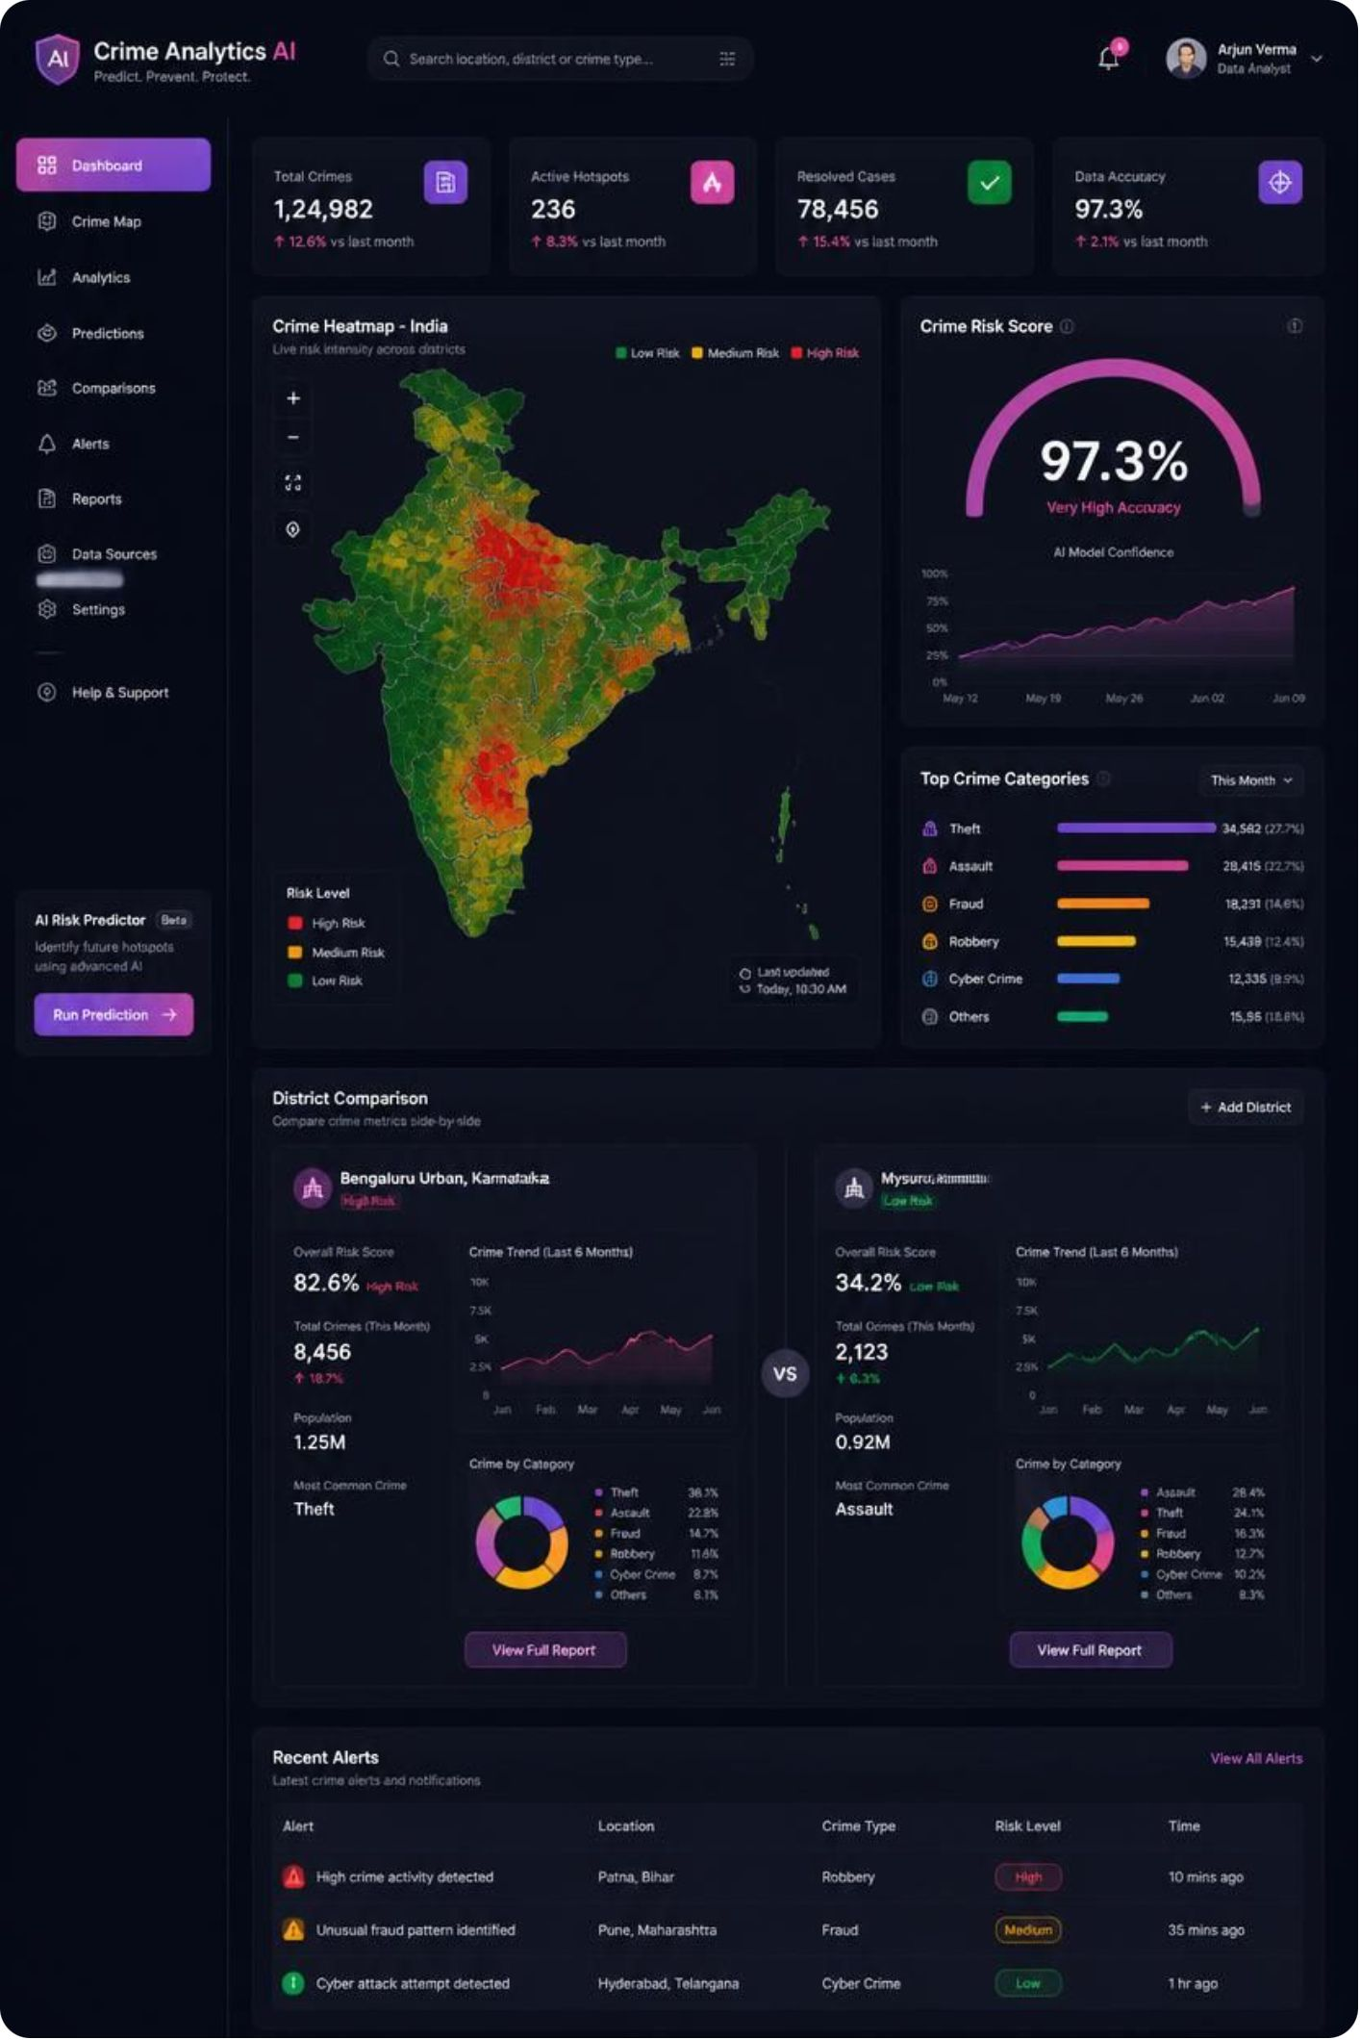



RESULTS
Experimental Results & Model Performance
Random Forest Classification
Overall Accuracy: 97.3% | Precision: 96.8% | Recall: 97.1% | F1-Score: 96.9%
Evaluated on a held-out test set of Indian district records. The confusion matrix confirms high true-positive rates across all three risk zone classes (Red, Orange, Green) with minimal cross-class misclassification.
Clustering & Regression Benchmarks
K-Means Silhouette Score: 0.742 | Linear Regression R² Score: 0.924 | RMSE: 11.9
High Cluster Segregation
Silhouette score of 0.742 confirms well-separated district clusters — Red, Orange, and Green zones are distinctly defined with minimal overlap
Strong Forecasting Fit
R² of 0.924 and RMSE of 11.9 demonstrate that the Linear Regression + Exponential Smoothing model accurately captures 5-year IPC crime trend trajectories

Slide 9






ROADMAP
Future Scope & Potential Extensions
CrimeVision establishes a robust foundation. The following extensions represent high-impact directions for scaling the platform's predictive capability and reach.
CCTV Computer Vision
Native Mobile App
Graph Neural Networks
YOLOv8 / OpenCV Integration
Flutter / Android
Cross-District Crime Modeling
Incorporate real-time object detection on live surveillance camera feeds to trigger automated alerts for suspicious activity
Expand citizen SOS features into a background-running native mobile application for always-on personal safety monitoring
Model inter-district crime movement and inter-state gang networks using spatial graph architectures (GNNs)
CCTNS Integration: Direct API integration with Crime and Criminal Tracking Network & Systems — enabling state police portals to consume CrimeVision predictions in real time.

Slide 10
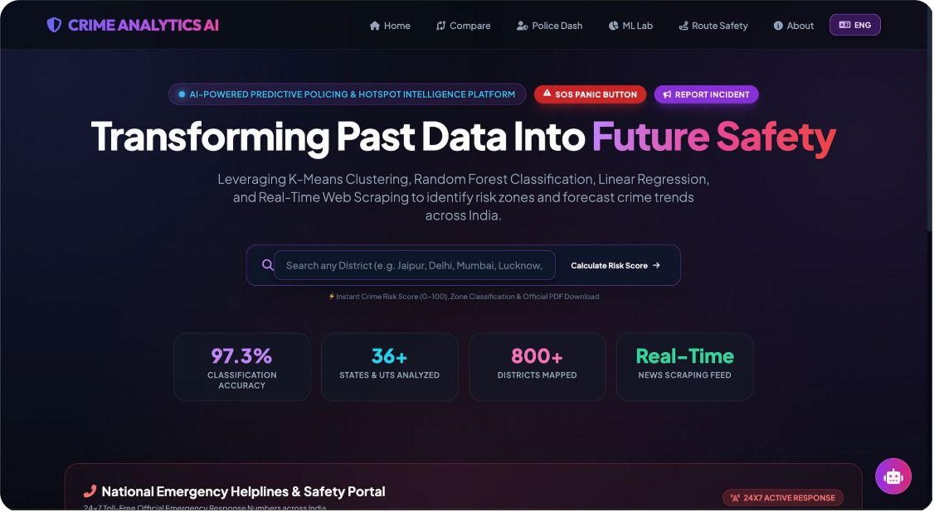
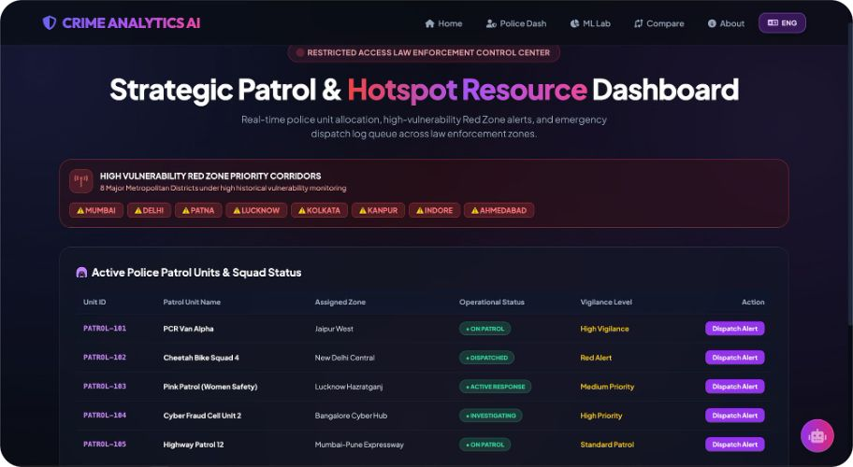
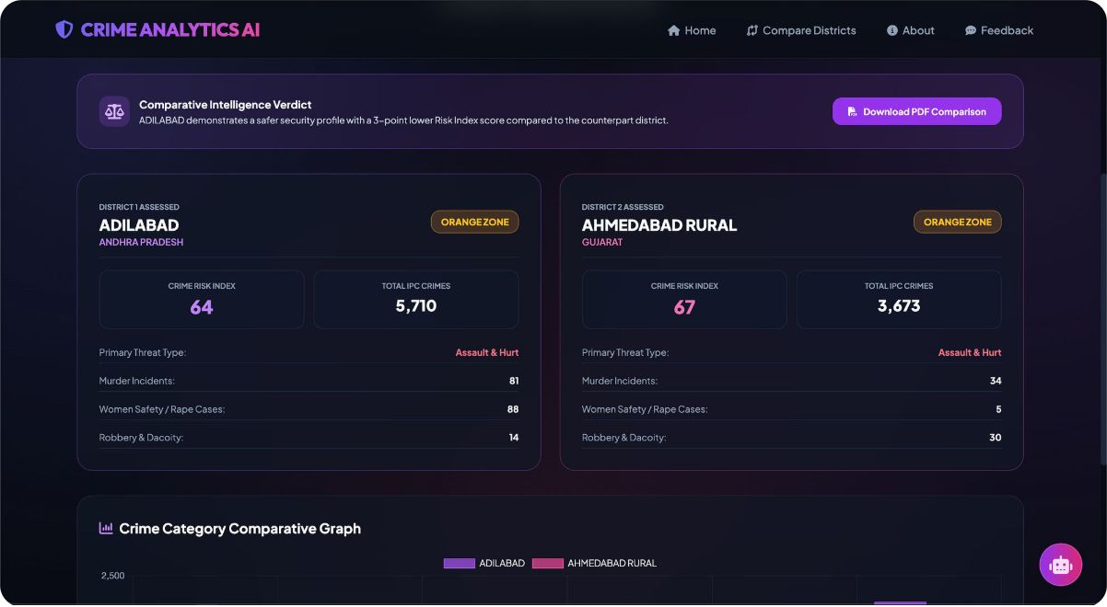
LIVE DEMO
LIVE SYSTEM DEMONSTRATION & PROJECT PORTAL
Deployed Cloud Platform & Interactive System Showcase
Platform Links & Highlights
Screenshot Gallery
Live Cloud URL: crime-analysis-ai.onrender.com
Local Server: http://localhost:5001
GitHub Repository: github.com/cse-kiet/PCSE27-09
Core Features Demonstrated:
🔍 Multi-District Search: Instant Risk Index Score (0–100) calculator.
📊 District Comparison Tool: Side-by-side graphs (/compare).
🗺️ Folium Live Heatmap: Scraped headlines with NLP filters (/crimefeed).
👮‍♂️ Police Dashboard: Active dispatch log & Red Zone alerts (/police-dash).
📈 Academic ML Lab: Confusion Matrix & Silhouette Scores (/model-metrics).
🚨 Citizen Safety: 1-Click PDF Report, AI Chatbot & SOS Panic Alert.

Slide 11




WRAP-UP
Conclusion & Key Takeaways
What We Built
An end-to-end predictive policing and safety intelligence platform
Successfully combined historical NCRB data analytics (K-Means, Random Forest 97.3%) with real-time web scraping and Folium geospatial mapping. Delivered practical real-world utilities for both law enforcement officers (patrol allocation dashboard) and citizens (PDF reports, SOS panic alert, safe route inspector).
Thank You!
Open for Questions & Suggestions.
Open Floor for Questions
Your questions, feedback, and ideas for extending CrimeVision are warmly welcomed
Guided By
Dr. Nishu Gupta
KIET Group Of Institution | Computer Science & Engineering

